Slide 1
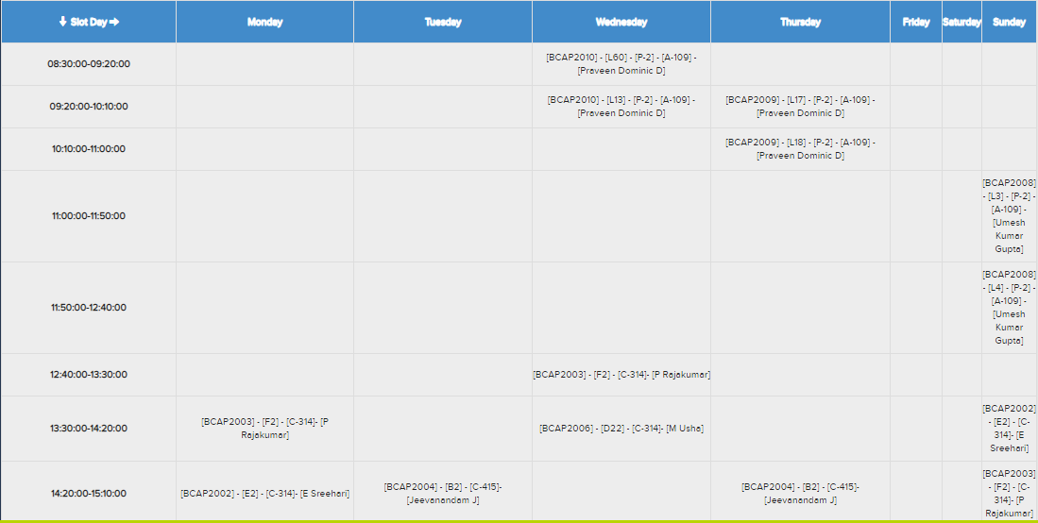
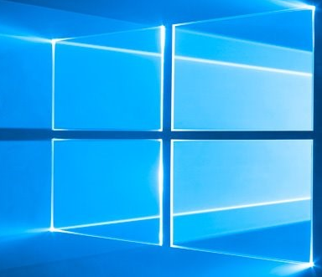

TIME TABLE
DATE | TIME
20-11-2018 | 02:30
WINDOWS COACHING INSTITUTION
LOGIN ID :- DEMO
PASSWORD :- ******
CREATE NOTES
TODAY’S NOTES
DOWNLOADS
SIGN IN
CREAT ACCOUNT
FORGOT PASSWORD

Slide 2
SUBJECT
type here
SAVE

Slide 3
LOGOUT
SETTINGS
ALERTS
DATE | TIME
20-06-2018 | 09:24
HELLO MR. DEMO GOOD MORNING !!!ALERT!!!*
ATTENDANCE IS LESS INCOMPLETE QUIZ
COURSE
SUPPORT
FACULTY TREE

Slide 4
LOGOUT
SETTINGS
ALERTS
DATE | TIME
20-06-2018 | 09:24
HELLO MR. DEMO GOOD MORNING !!!ALERT!!!
THEORY
LABS
ATTENDANCE IS LESS INCOMPLETE QUIZ
COMPUTER NETWORKS DATABASE JAVA ALGORITHMS
COMPUTER NETWORKS JAVA
COURSE
SUPPORT
FACULTY TREE

Slide 5
LOGOUT
SETTINGS
ALERTS
DATE | TIME
20-06-2018 | 09:24
HELLO MR. DEMO GOOD MORNING !!!ALERT!!!
THEORY
ATTENDANCE IS LESS INCOMPLETE QUIZ
COMPUTER NETWORKS
Your Notes
Faculty Notes
COURSE
Add Notes
SUPPORT
FACULTY TREE

Slide 6
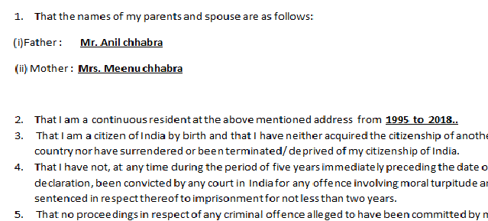
LOGOUT
SETTINGS
ALERTS
DATE | TIME
20-06-2018 | 09:24
HELLO MR. DEMO GOOD MORNING !!!ALERT!!!
THEORY
ATTENDANCE IS LESS INCOMPLETE QUIZ
COMPUTER NETWORKS
Your Notes
COURSE
SUPPORT
FACULTY TREE

Slide 7
LOGOUT
SETTINGS
ALERTS
DATE | TIME
20-06-2018 | 09:24
HELLO MR. DEMO GOOD MORNING !!!ALERT!!!
SUPPORT
ATTENDANCE IS LESS INCOMPLETE QUIZ
Attendance Issue
Maintenance Issue
Admit Card Issue
COURSE
Fees Issue
SUPPORT
FACULTY TREE

Slide 8
LOGOUT
SETTINGS
ALERTS
DATE | TIME
20-06-2018 | 09:24
HELLO MR. DEMO GOOD MORNING !!!ALERT!!!
SUPPORT
ATTENDANCE IS LESS INCOMPLETE QUIZ
Attendance Issue
TYPE HERE
COURSE
SUPPORT
FACULTY TREE
SEND

Slide 9
LOGOUT
SETTINGS
ALERTS
DATE | TIME
20-06-2018 | 09:24
HELLO MR. DEMO GOOD MORNING !!!ALERT!!!
Faculty Tree
PROGRAMME
SCSE
ATTENDANCE IS LESS INCOMPLETE QUIZ
Your Need | Faculty Name | Cabin No.
DEAN | Dr.ShreeNivas | C-101
Programme Chair | Dr.Ritu Singh | C-303
GU RF Campus | TEAM | A-038
LMS | TEAM | C-321 A-322
Introdution of Algorithm | Dr. Jeevanandan | A-335
Computer Networks | Mr. P Rajkumar | C-342
COURSE
SUPPORT
FACULTY TREE

